Slide 1
Week 10 DevOps
Dr Zhi Zhang

Slide 2
Overview
DevOps
Fabric
AWS Lambda

Slide 3
What is DevOps?
It is a combination of cultural philosophies, practices and tools created to facilitate organizations in delivering services/applications much faster than they can through traditional software development.

Slide 4
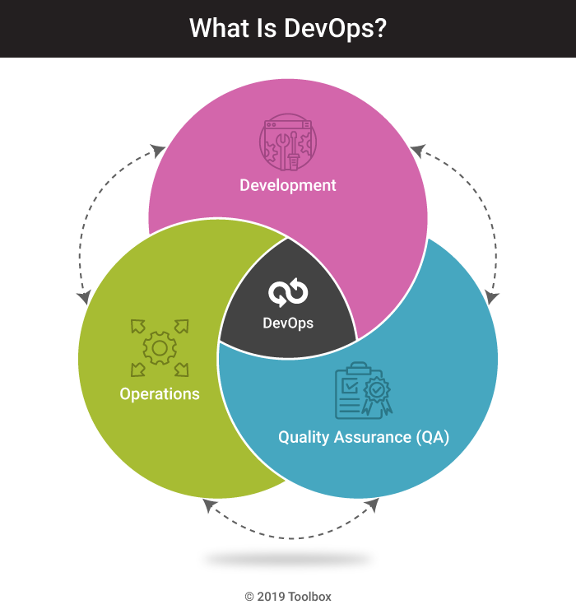
https://www.spiceworks.com/tech/devops/articles/what-is-devops/

Slide 5
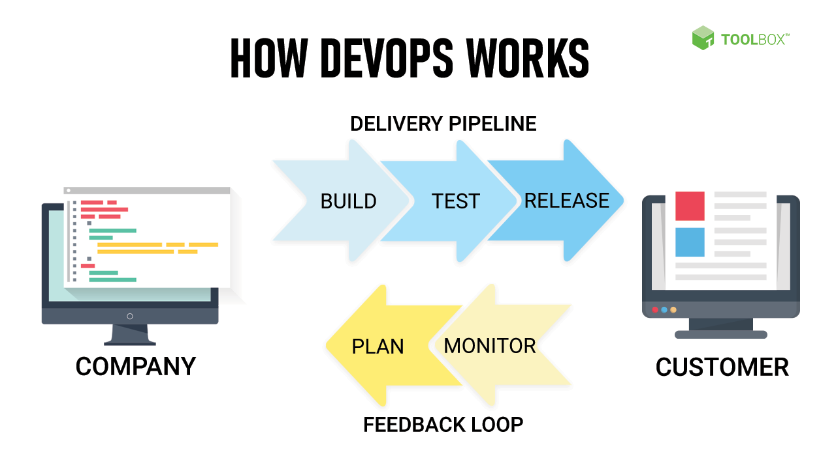
https://www.spiceworks.com/tech/devops/articles/what-is-devops/

Slide 6
DevOps best practices
Microservice
Monitoring and Logging
Continuous Integration
Continuous Delivery
Continuous Deployment

Slide 7
DevOps best practices
Microservice
A design approach to build a single application as a set of small services. Each service runs in its own process and communicates with other services through network.
Applications are broken into many individual microservices with each microservice scoped to a single purpose or function.

Slide 8
DevOps best practices
Microservice
A design approach to build a single application as a set of small services. Each service runs in its own process and communicates with other services through network.
Applications are broken into many individual microservices with each microservice scoped to a single purpose or function
Makes the application flexible and enable frequent and small updates.
Example: AWS Lambda.

Slide 9
DevOps best practices
Monitoring and Logging
Organizations monitor metrics and logs to see how application and infrastructure performance impacts the experience of their product’s end user.
Tracks the performance of applications and infrastructure and detects real-time problems.
Example: AWS CloudWatch.

Slide 10
DevOps best practices
Continuous Integration
Continuous Delivery
Continuous Deployment

Slide 11
The software/application release process:
Source Control:
Developers use a VCS (Version Control System) to manage and track changes to a code repository.
Run Build and Unit Tests:
Deploy to Test Environment:
Deploy to Production Environment:

Slide 12
The software/application release process:
Source Control:
Run Build and Unit Tests:
Build refers to automatically compiling the code, resolving dependencies, and generating executables for the application.
Automated unit tests are executed to ensure that individual components of the application function correctly.
Failures in build and unit tests alert the developers.
Deploy to Test Environment:
Deploy to Production Environment:

Slide 13
The software/application release process:
Source Control:
Run Build and Unit Tests:
Deploy to Test Environment:
Automated deployment to the test environment.
Test Environment: a dedicated test environment mirrors the production environment but is isolated for testing purposes.
Test includes functional testing, integration testing, workload testing, etc.
Deploy to Production Environment:

Slide 14
The software/application release process:
Source Control:
Run Build and Unit Tests:
Deploy to Test Environment:
Deploy to Production Environment:
The application is deployed to the production environment for serving real users.

Slide 15
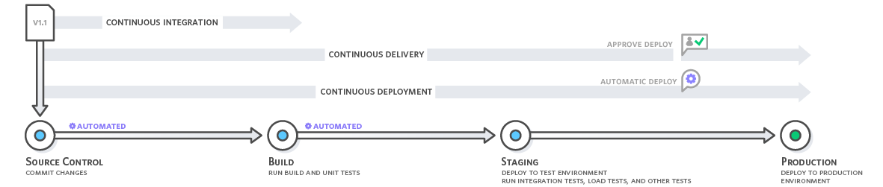
The software/application release process:
Source Control:
Run Build and Unit Tests:
Deploy to Test Environment:
Deploy to Production Environment:

Slide 16
DevOps best practices
Continuous Integration
Every time developers merge their code changes into a central repository, automated builds and tests start: Whenever a change is committed, the automated build and test will be triggered.
Benefits: ?
https://aws.amazon.com/devops/continuous-integration/

Slide 17
DevOps best practices
Continuous Integration
Every time developers merge their code changes into a central repository, automated builds and tests start: Whenever a change is committed, the automated build and test will be triggered.
Benefits: Improve Developer Productivity, Find and Address Bugs Quicker, Deliver Updates Faster
https://aws.amazon.com/devops/continuous-integration/

Slide 18
DevOps best practices
Continuous Delivery and Continuous Deployment:
Expand upon continuous integration by deploying all code changes to a testing environment and/or a production environment after the build stage.
Benefits: ?
https://aws.amazon.com/devops/continuous-integration/

Slide 19
DevOps best practices
Continuous Delivery and Continuous Deployment:
Expand upon continuous integration by deploying all code changes to a testing environment and/or a production environment after the build stage.
Benefits: Continuous Integration + Automate the Software Release Process
https://aws.amazon.com/devops/continuous-integration/

Slide 20
Fabric: automate tasks in DevOps
Fabric is a high level Python library designed to execute shell commands remotely over SSH, yielding useful Python objects in return.
OpenSSH: a widely used version of the SSH protocol, available on Mac, Linux/Unix and Windows.
Question: how is OpenSSH used for user/client authentication?

Slide 21
User/Client Authentication in SSH
https://sebastien.saunier.me/blog/2015/05/10/github-public-key-authentication.html

Slide 22
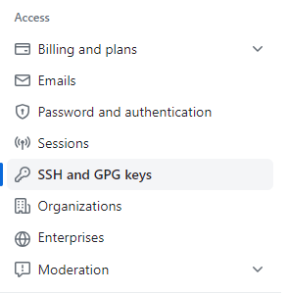
Add the public key to GitHub
Check for existing OpenSSH keys:
ls ~/.ssh
Generate OpenSSH keys if no key pairs exist:
ssh-keygen -t rsa -b 4096 -C email@example.com
private key: id_rsa
public key: id_rsa.pub
Add the Public Key to GitHub:

Slide 23
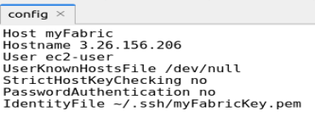
How to configure OpenSSH to support Fabric
Install fabric using: pip install fabric
Create a config file in ~/.ssh

Slide 24
How to configure OpenSSH to support Fabric
Install fabric using: pip install fabric
Create a config file in ~/.ssh
Question: Some settings in the configuration above will make the SSH connection NOT secure? What are they? Justify your answer.

Slide 25
How to configure OpenSSH to support Fabric
Install fabric using: pip install fabric
Create a config file in ~/.ssh
Question: Some settings in the configuration above will make the SSH connection NOT secure? What are they? Justify your answer.
Both “UserKnownHostsFile /dev/null” and “StrictHostKeyChecking yes” have disabled host key checking, making the connection unsecure to the client.
To explain why, we need to be aware of “server/host authentication”.

Slide 26
Server/Host Authentication in SSH
Key pair: host key is a key pair. Public host key is stored on and distributed to different clients, and private key is stored on the host/server.
Key Exchange: when a client attempts to connect to a server for the first time

Slide 27
Server/Host Authentication in SSH
Key Exchange: when a client attempts to connect to a server for the first time, the server presents its host public key to the client.

Slide 28
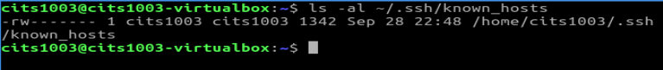
Server/Host Authentication in SSH
The host-key database is called known_hosts in Linux and contains known host keys.

Slide 29
Server/Host Authentication in SSH
Host Key Checking: The client checks the server's host key against a copy stored in its "known_hosts" file. If the check succeeds, the server is authenticated.

Slide 30
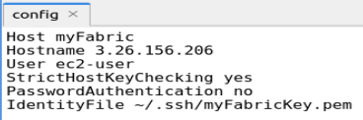
Enable Server/Host Authentication in SSH

Slide 31
Fabric: common functions
from fabric import Connection
c = Connection('myFabric')
upload a local file to the remote server
c.put(localfile, remotefilepath)
run a remote command
c.run(command, otherargs)
run a remote command with sudo
c.sudo(command, otherargs)

Slide 32
Fabric: common functions
from fabric import Connection
c = Connection('myFabric')
upload a local file to the remote server
c.put(localfile, remotefilepath)
run a remote command
c.run(command, otherargs)
run a remote command with sudo
c.sudo(command, otherargs)
Question: what are the differences between 'sudo' and 'su'?

Slide 33
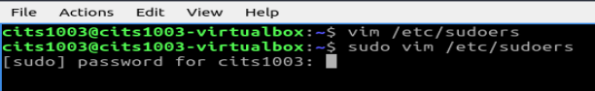
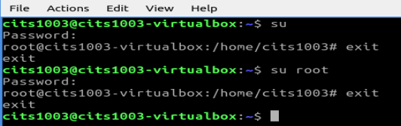
Question: what are the differences between 'sudo' and 'su’?
sudo (Superuser Do): allows a user to execute specific commands that require superuser privileges.
su (Switch User): allows a user to switch to another user account by entering that account's password.

Slide 34
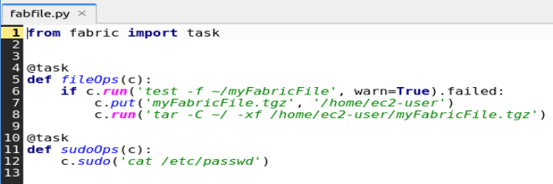
fabfile.py: a Python script that is a collection of tasks and functions
@task is a decorator from the Fabric library.
Question: what does the code snippet above primarily do?

Slide 35
@task is a decorator from the Fabric library.
Question: what does the code snippet above primarily do?
A task named fileOps is defined. It first checks if a file named myFabricFile exists in the home directory of the remote host. If the check does not exist, the warn=True argument prevents the check from aborting, and instead will return a warning. Besides, the task uploads a file named myFabricFile.tgz to the remote host’s directory of ‘/home/ec2-user’. Then, it extracts the contents of myFabricFile.tgz into the remote host's home directory.
The other task named sudoOps is defined: This task executes the ‘cat /etc/passwd command’ with elevated privileges.

Slide 36
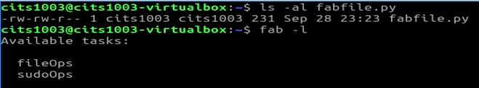
Execute fabfile.py
Navigate to the directory where the fabfile.py resides:

Slide 37
AWS Lambda: automate tasks in DevOps
Lambda is a compute service that lets us run code without provisioning or managing servers. With Lambda, all we need to do is supply our code in one of the language runtimes that Lambda supports.
Lambda runs our code automatically on a high-availability compute infrastructure and performs all of the administration of the compute resources, including server and operating system maintenance, capacity provisioning and automatic scaling, and logging.

Slide 38
AWS Lambda: automate tasks in DevOps
Examples:
A toy lambda function
A combination of lambda function and S3

Slide 39
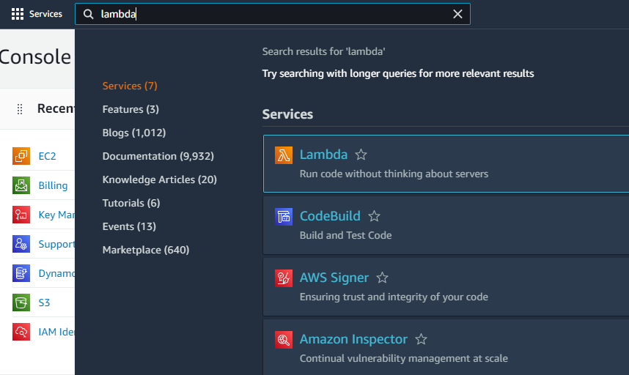
Step1: open the AWS Lambda Console

Slide 40
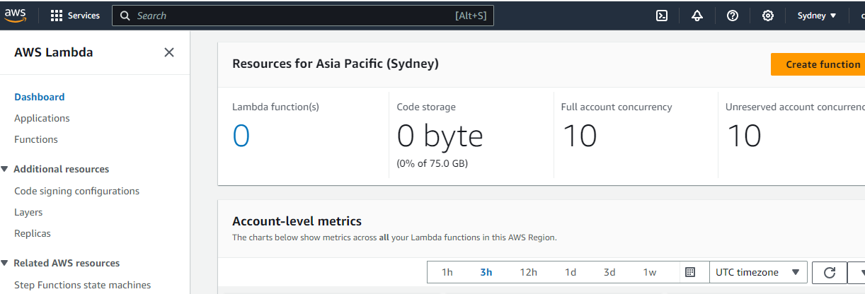
Step1: open the AWS Lambda Console

Slide 41
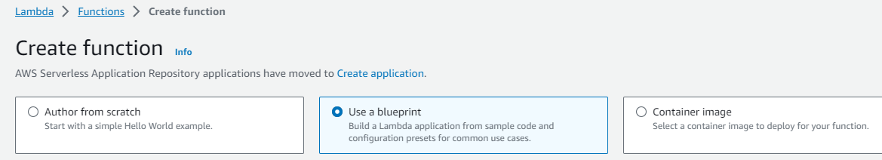
Step2: select a Lambda blueprint and configure it

Slide 42
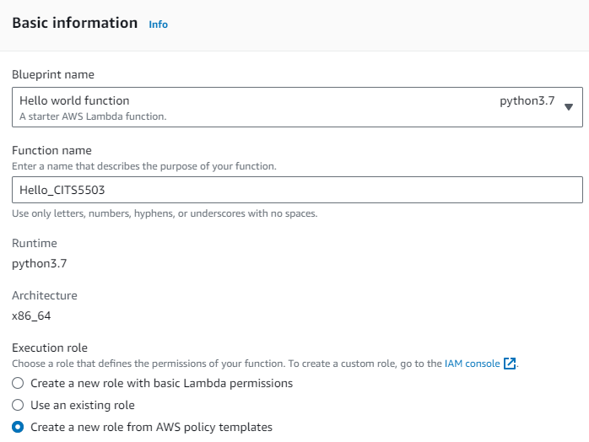
Step3: basic information configuration
Execution role: an IAM role that grants a Lambda function permission to access AWS services and resources

Slide 43
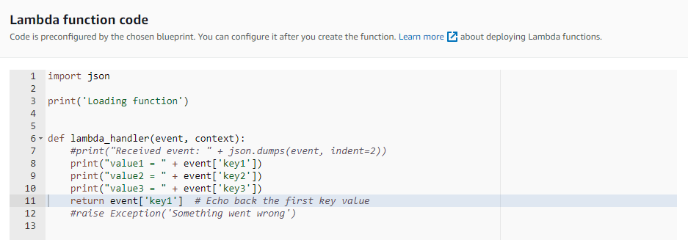
Step3: basic information configuration

Slide 44
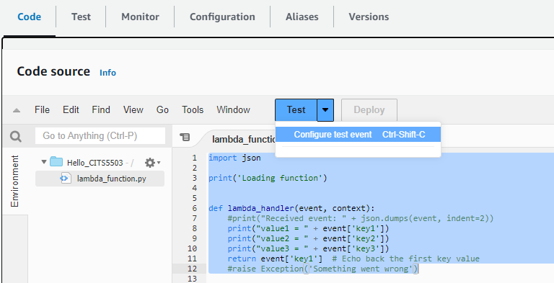
Step4: invoke Lambda function and verify results

Slide 45
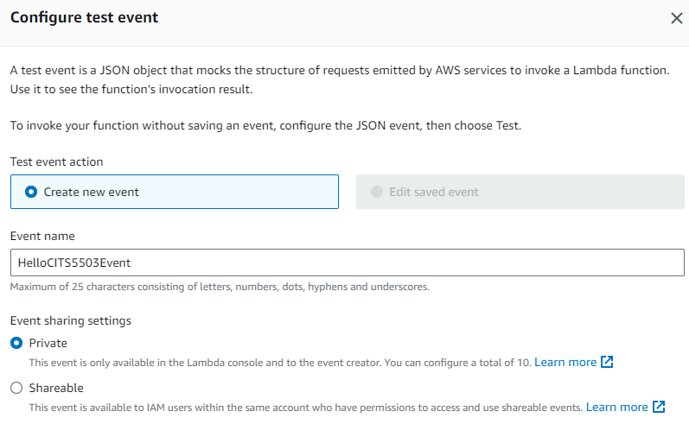
Step4: invoke Lambda function and verify results

Slide 46
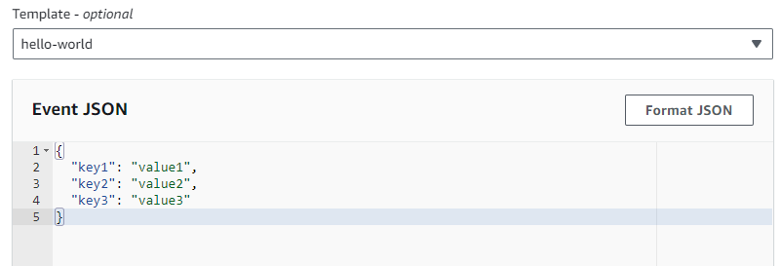
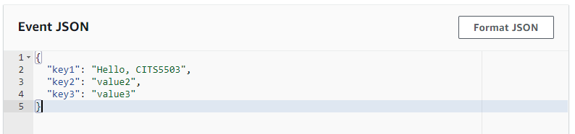
Step4: invoke Lambda function and verify results

Slide 47
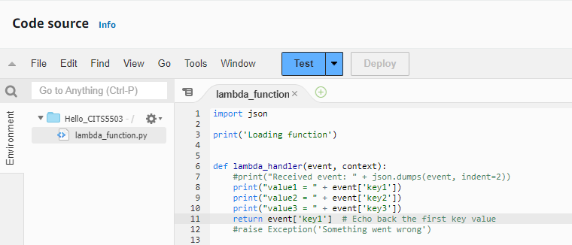
Step4: invoke Lambda function and verify results

Slide 48
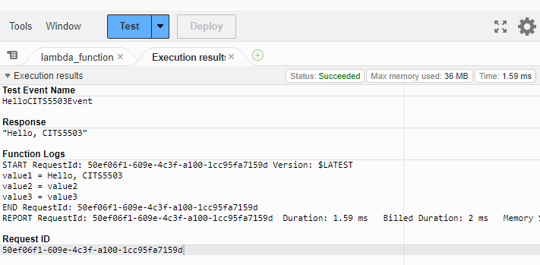
Step4: invoke Lambda function and verify results

Slide 49
AWS Lambda: automate tasks in DevOps
Example:
A toy Lambda function
A combination of lambda and S3

Slide 50
Combine Lambda with S3
IAM
S3 BUCKET
Lambda
Create policy
Create BUCKET
Create function
Create role
Lambda
Lambda
Test with trigger
Add trigger

Slide 51
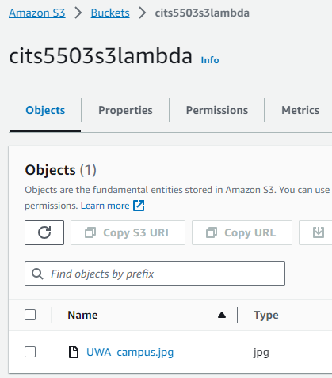
Step1: create an Amazon S3 bucket and upload the test object

Slide 52
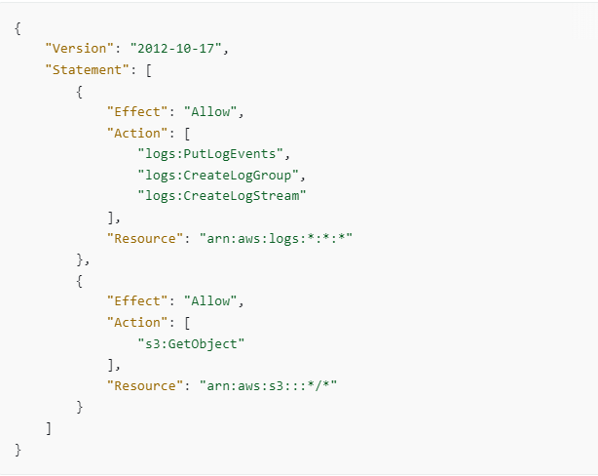
Step2: create a permissions policy

Slide 53
Step2: create a permissions policy
A log stream is a sequence of log events that share the same source. Each separate source of logs in cloudwatch logs makes up a separate log stream.
A log group is a group of log streams that share the same monitoring settings.
This permissions policy allows read actions against s3 buckets and write actions against cloudwatch logs.

Slide 54
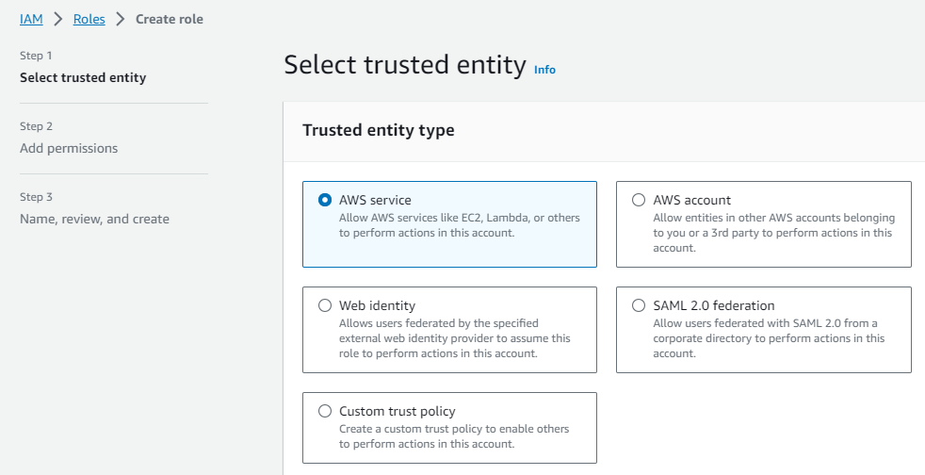
Step3: create an execution role

Slide 55
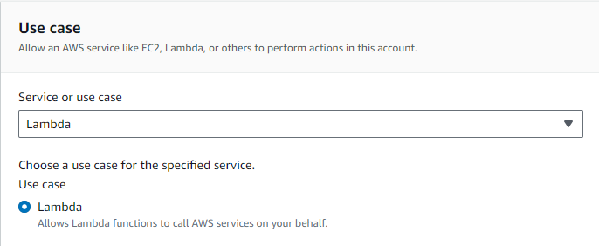
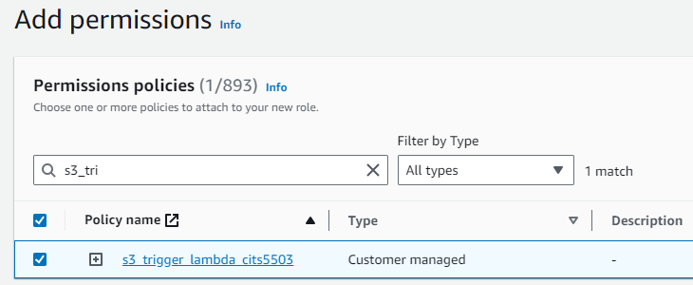
Step3: create an execution role

Slide 56
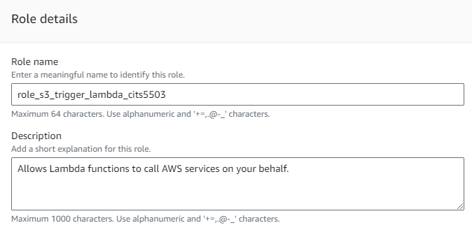
Step3: create an execution role

Slide 57
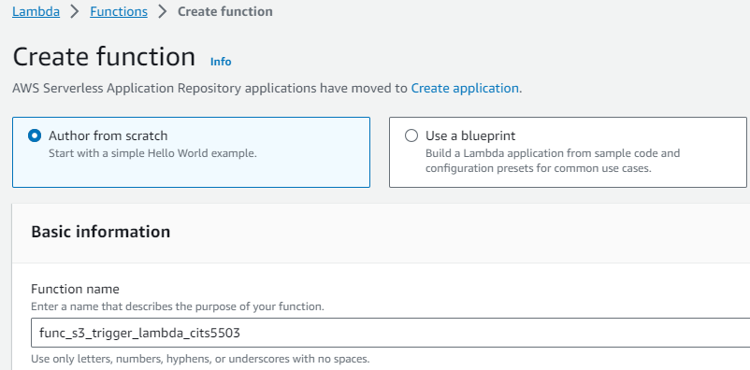
Step4: create the lambda function

Slide 58
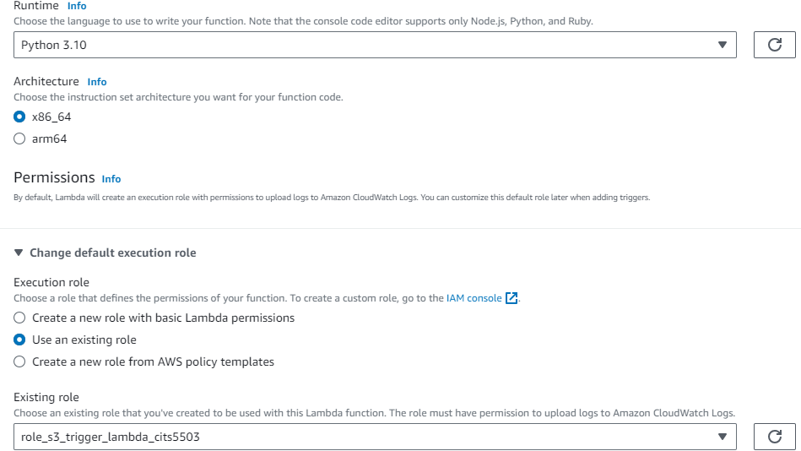
Step4: create the lambda function

Slide 59
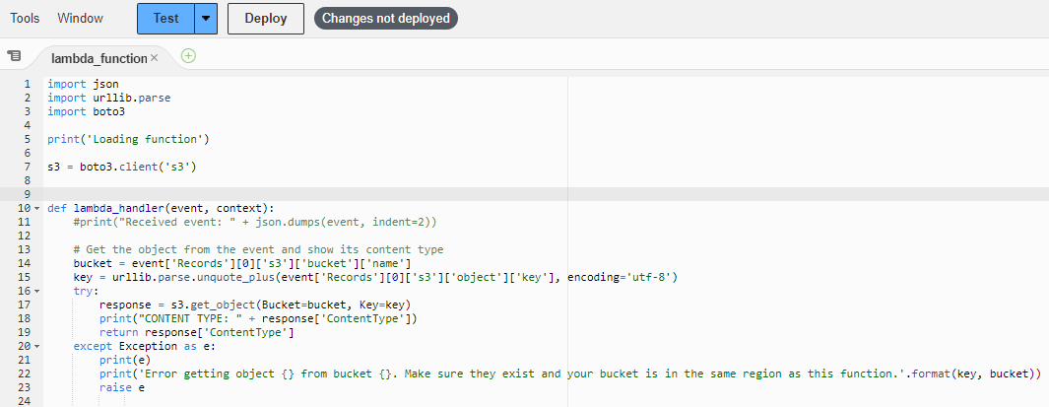
Step4: create the lambda function

Slide 60
Step4: create the lambda function
event['Records']: contains an array of records. Each record corresponds to a specific event that triggered the lambda function.
event['Records'][0]: retrieves the first record in this array.
event['Records'][0]['s3']: contains information specific to an S3 event in the record.
event['Records'][0]['s3']['bucket']: contains information about the S3 bucket where the S3 event occurred.
event['Records'][0]['s3']['bucket']['name’]: retrieves the name field from the bucket.

Slide 61
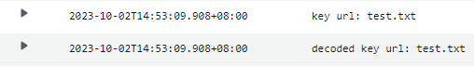
Step4: create the lambda function
event['Records'][0]['s3']['object']['key']: retrieves the S3 object key from the S3 object, encoded by utf-8.
urllib.parse.unquote_plus(): a function call that decodes an encoded URL string.
encoding='utf-8: specifies the character encoding to be used when decoding the object key.

Slide 62
Step4: create the lambda function

Slide 63
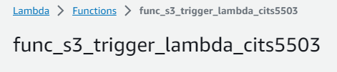
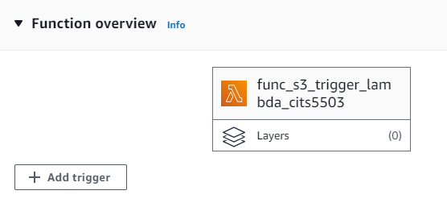
Step5: create the S3 trigger

Slide 64
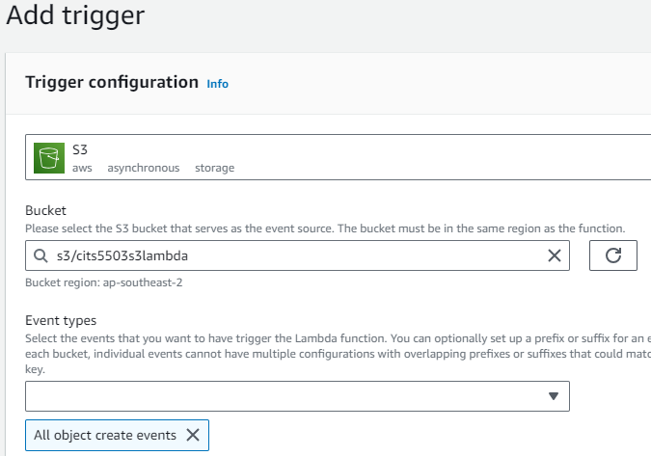
Step5: create the S3 trigger

Slide 65
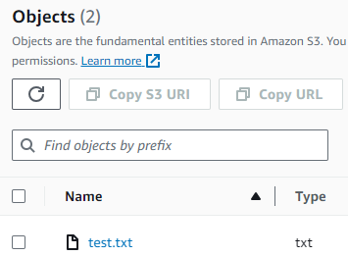
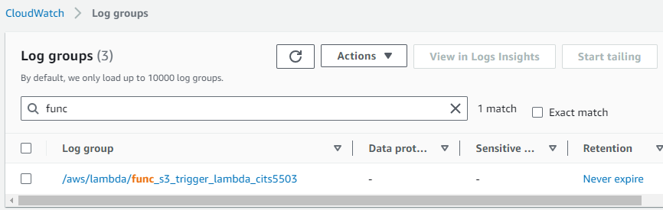
Step6: test the Lambda function with the S3 trigger

Slide 66
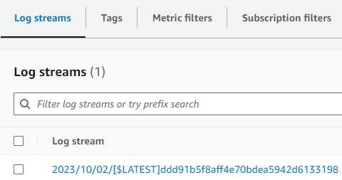
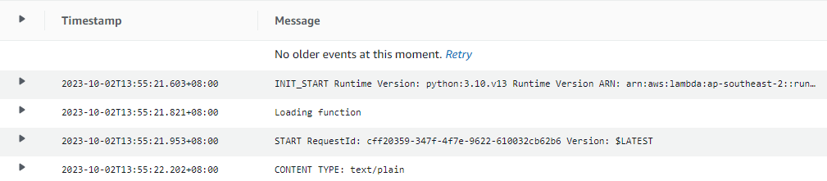
Step6: test the Lambda function with the S3 trigger

